Slide 1








_
X
NetStat V1.0
INICIAR
TRACK IP
INICIAR
Tracert, Data & Locations Map

Slide 2


_
X
NetStat V1.0
TRACK IP
Tracert, Data & Locations Map
INICIAR

Slide 4
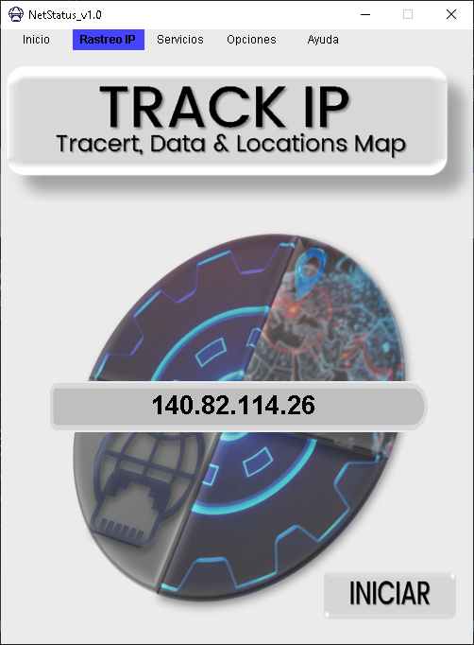
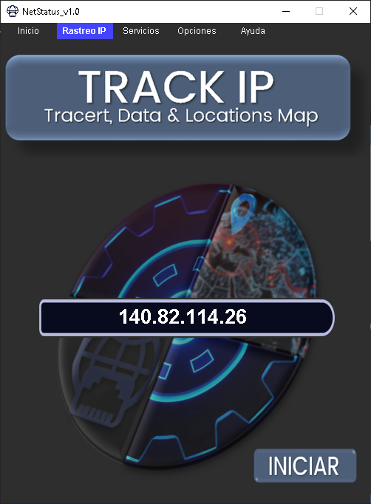
DARK
&
LIGHT

Slide 5
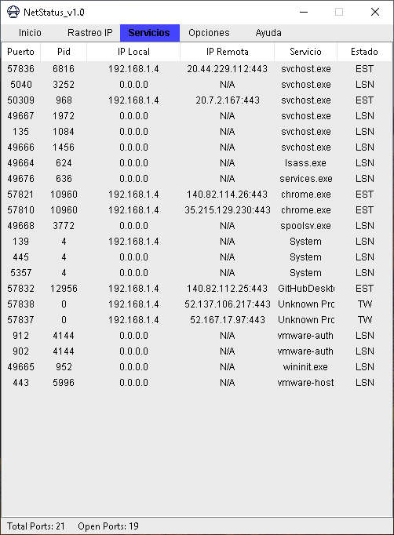
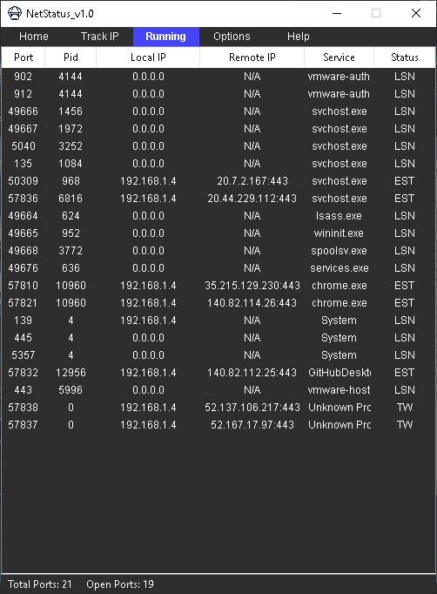
Englis
&
Spanish

Slide 6
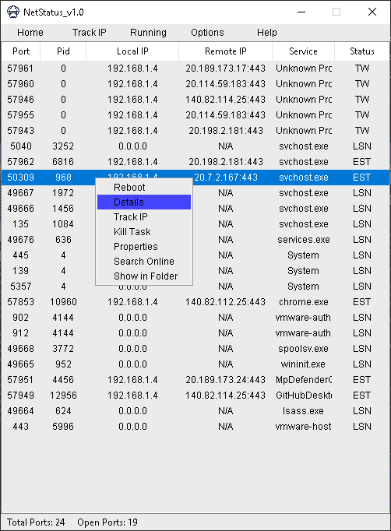
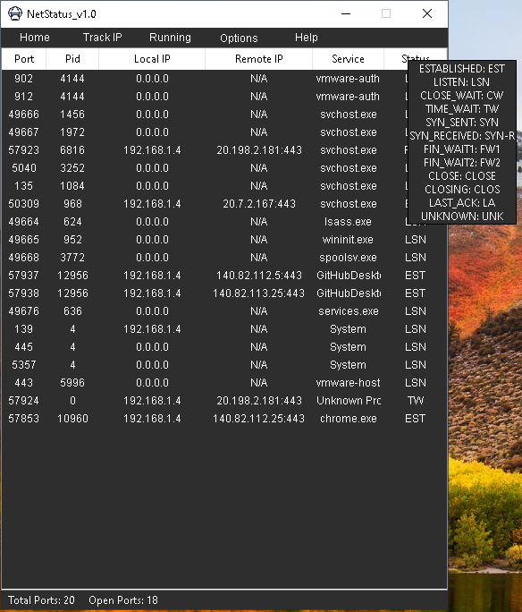
Englis
&
Spanish

